Slide 2
Chemical
Mechanical
Planarization
Techniques and Developments

Slide 3
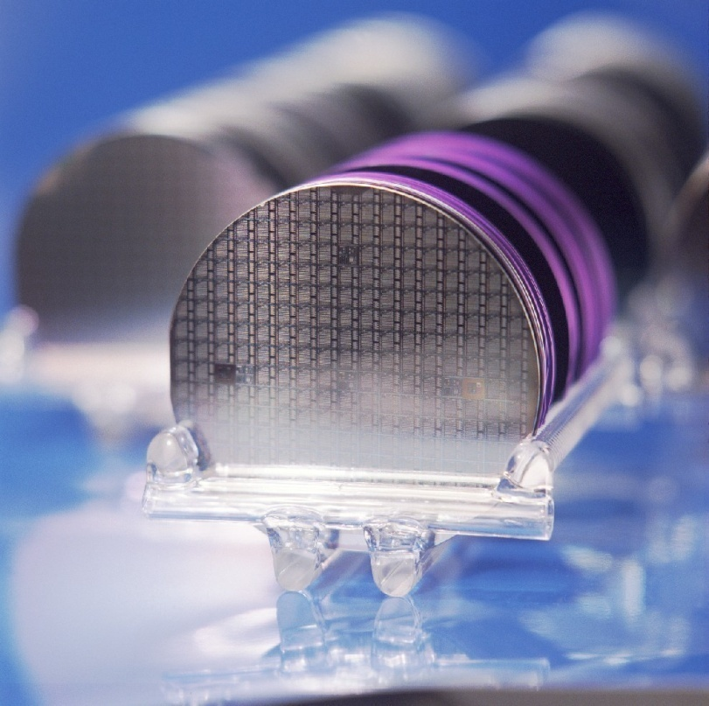
Chemical Mechanical Planarization Contents
What is CMP
The Mechanics of CMP
The Pad
The Slurry
What Can go Wrong
Future Developments
Notes:
During mechanics, also note the modeling of CMP Processes

Slide 4
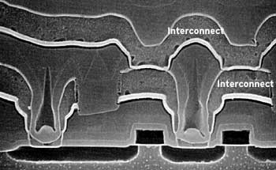
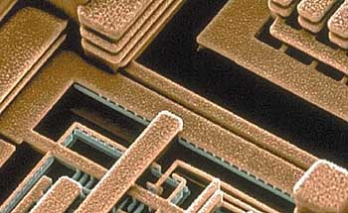
What is Chemical Mechanical Planarization?
CMP creates very flat wafer surfaces for each new metal layer to be built upon
Historically a dirty process
Necessary for more than 3 metal layers
Devices Without Planrization
Planarized Circuit
Notes:
Issues will arise when there is no planarization such as wells not getting filled properly and eventually non-connected deposited layers. Allows for accutate resist patterning, needed for smaller technologies.

Slide 5
The Mechanics of Planarization
Wafer placed upside down in carrier
Forced against an abrasive pad with slurry
Gimbal point applies pressure onto wafer
Notes:
Carrier Rotates around the gimabl point. The carrier film and the bottom pad are compresble to mainitain a uniform pressure.

Slide 6
CMP Modeling – Preston’s Law
Prestons’s Law: RR = (Kp)*(P)*(v)
RR: Removal Rate
P: Pressure
V: Velocity
Kp: Process Constant
Pressure on Wafer
Velocity of Wafer Relative to pad
SiO2 Film to be Planarized
Abrasive Particles
Top Pad

Slide 7
CMP Modeling – Preston’s Law
Prestons’s Law: RR = (Kp)*(P)*(v)
Intuitive equation, generally valid for SiO2 polishing
Faster removal rate on less feature dense surface
Factors that go into the Kp term
Film type/properties
Abrasive particle details (size, amount, composition)
Slurry variables (pH, composition, amount, viscosity)
Temperature and pad variables
Notes:
Often the Kp term is rather costant for a cetian process. Normal Pressure terms tend to be lass than 10 psi. V is typically between 50 and 500 meters per minute

Slide 8
Rotary Polishing Devices
V = 2πrf
Instantaneous Velocity
Not uniform abrasion across wafer
Better rotary polishing spins wafer and move across platen
Slurry
Wafer Carrier
Pad Cleaner
Platen
f

Slide 9
Other Mechanical Polishing Techniques
Variations on rotary polishing
Carousel and Orbital
Linier Polishing
Constant Velocity
When is polishing complete?
Time it
Monitor motor current and vibrations
Optical measurements
Wafer
v
Polishing Pad
Notes:
Describe basic polishing techniques. Linier Constant velocity important for consistent polish.

Slide 10
The Pad -- Characteristics
Must be hydrophilic (soaks liquid)
Allows for pad/slurry reactions
Commonly made of Polyurethane
Measured and predictable substance, chemically stable
Many pad varieties

Slide 11
The Pad – Commonly Used Structures
Micropourus Polymer Sheet
Grooved Pad Structure
Polyurethane foam with crater-like pores
Pad cured at high temperatures
Best for SiO2 polishing and better slurry loading
Stiffer
Less slurry loading
Better for planarizing metals
All top pads rest on more flexible bottom pad

Slide 12
The Pad – Variables affecting Removal Rate
Pad Thickness
Determines stiffness of pad
2x thickness = 8x stiffness
Normally 1.3mm to 2.0mm thick
Groove Designs – Spirals, Circles, Squares, Rays
Prevents hydroplaning of wafer
Allows slurry to penetrate whole wafer
Base Pad – Impacts curvature of top pad
Notes:
No grooves means nowhere for the slurry to go, also prevents edje effects. Planiarity quotient is the oxide removal rate at the bottom of a trench divided by the rate at the top.

Slide 13
The Slurry – Purpose
Why do we need a slurry?
Transporting waste particles from the wafer surface
Abrasive particles
Controlling pH and temperature
Lubricating the pad and wafer
Can etch one material faster then another with a specific slurry type
Two main slurry components are solution and solids
Notes:
Other chemical effects are also presnt with the slurry

Slide 14
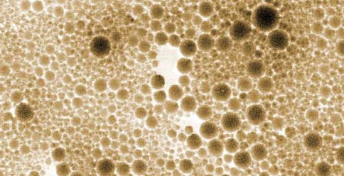
Slurry Composition
Solution
Solids
Big mixture of chemicals
Surfactants
Inhibitors
Oxidizers
Other compounds
Particles that allow for a polishing effect on the wafer surface
Factors in removal rate include:
Particle size (7-30 nm)
Concentration (9-15%)
Type (silica or alumina)
Solids in a slurry

Slide 15
What goes wrong -- Dishing
Dishing is a dip in metal lines caused by over-polishing and slurry composition
Results in decreased average thickness
Increased line resistivity
Reduced signal propagation speeds
Decreases overall planarity
Can be prevented with precise CMP timing or optical sensing
-- If many metal vias are in a row, erosion can occure
Notes:
Some modern slurry compositions have a 1:1 etch rate for oxide and metal, which can prevent some issues, but not all. The analysis gets more complex since most vias are coated with a film of titmnium, which will be etched at a differnet rate then either copper or oxide.

Slide 16
Future CMP Advancements

Slide 17
Works Cited

Slide 18
Hidden Feature

