Slide 1
Time and Statistical Information Utilization in SAR ADCs
Jon Guerber December 4, 2012
Advisor: Dr. Un-Ku Moon
School of Electrical Engineering and Computer Science
Oregon State University, Corvallis, OR
Notes:
Grab Coffee/Snacks and Settle in

Slide 2
SAR ADC Outline
ADC Motivation
MCS and EMCS Structures
The Ternary SAR (TSAR)
Residue Shaping
The Feedback Initialized TSAR
Conclusions

Slide 3
SAR ADC Outline
ADC Motivation
  Power Aware ADCs
  SAR ADC Benefits
MCS and EMCS Structures
The Ternary SAR (TSAR)
Residue Shaping
The Feedback Initialized TSAR
Conclusions

Slide 4
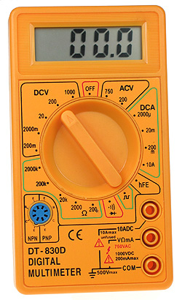
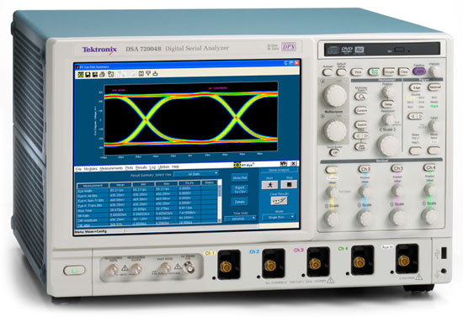


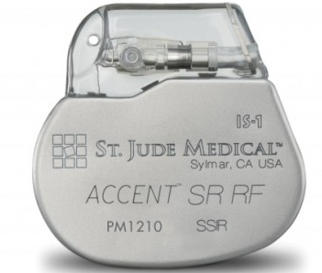
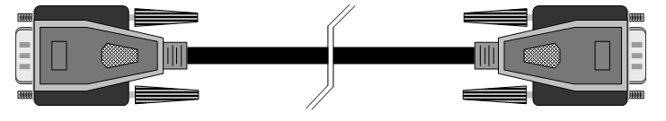
The Need for ADCs
Analog to Digital Conversion
  Used when digital processing units require data from analog real-world sources
  Important parameters: accuracy, bandwidth, power, cost, size …

Slide 5
ADC Motivation
Power Aware ADCs
  Power is becoming vital in portable and medical electronics applications
  Digital computational computations / Joule doubles every 1.5 years [1| Intel 2009]
  ADC samples / Joule doubles every 3.3 years [2| Murmann 2010]
Successive Approximation ADCs
  Provide an efficient operation in the 6-14b resolution range with bandwidths below 100MHz

Slide 6
SAR Motivation
SAR ADC Design
  Based on feedback subtraction
  Single comparator as quantizer unit
  Feedback subtraction accomplished with passive elements (Caps or Resistors)
SAR Design Benefits
  Low Power: Dynamic, High efficiency
  Scalable: Good Small Process node FOM, Small Area
  Moderate Speed/Accuracy ( < 100MHz, 6-14 Bits)
Notes:
ITRS Grand Challenges: High performance and low-cost RF and Analog/Mixed Signal Solutions – Including in ever shrinking technology nodes

Slide 7
SAR Motivation
SAR ADC Design
  Based on feedback subtraction
  Single comparator as quantizer unit
  Feedback subtraction accomplished with passive elements (Caps or Resistors)
SAR Design Benefits
  Low Power: Dynamic, High efficiency
  Scalable: Good Small Process node FOM, Small Area
  Moderate Speed/Accuracy ( < 100MHz, 6-14 Bits)
Notes:
ITRS Grand Challenges: High performance and low-cost RF and Analog/Mixed Signal Solutions – Including in ever shrinking technology nodes

Slide 8
SAR ADC Outline
ADC Motivation
MCS and EMCS Structures
  SAR ADC Operation
  Switching Efficiency Optimization
The Ternary SAR (TSAR)
Residue Shaping
The Feedback Initialized TSAR
Conclusions

Slide 9
Merged Capacitor Switching SAR
Merged Capacitor Switching (MCS)
  Sampling reference is Vcm [1,2]
  Differentially switches DAC
  Minimizes switching power
  Maintains virtual node common mode

Slide 10
MCS Switching Power
MCS Switching Power
  Saves switching energy over previous structures
  Switching efficiency come from the direct switching behavior of the DAC in each phase
  Beats the efficient of the competing “monotonic” method

Slide 11
Early Reset MCS (EMCS) SAR
EMCS Switching
  Uses different switching pattern then MCS
  On “10” and “01” transitions, previous DAC cap is reset and current cap is charged oppositely
  In each stage, current cap is charged to original MSB
  Comp output dictates resetting

Slide 12
Energy and Linearity Comparison
MCS vs. EMCS
  EMCS has 12.5% lower average switching energy (uniform input)
  18.4% lower with a Gaussian input
  Mathematically proven to be lower or equal energy for each code
  Static linearity improvements

Slide 13
SAR Performance Enhancements
Meaningful SAR Performance Improvements
  How can we better use 3-level DAC?
  Are we discarding any valuable information to find the input magnitude?

Slide 14
Comparator Delay Variation per Stage
Comparator Delay vs. Stage Voltage
Comparator Transfer Function
Comparator decision time increases linearly with stage
Comparator delay is an indicator of input magnitude

Slide 15
SAR ADC Outline
ADC Motivation
MCS and EMCS Structures
The Ternary SAR (TSAR)
  Redundancy, Speed and Power Improvements
  Stage Grouping, Skipping, Shaping
  Implementation Optimization
Residue Shaping
The Feedback Initialized TSAR
Conclusions

Slide 16
Ternary SAR (TSAR) Architecture
Ternary SAR (TSAR) uses comparator delay information to create a coarse third level
  Middle level is based on input magnitude
  DAC operation is skipped for a middle code

Slide 17
TSAR Redundancy
TSAR Provides 1.5b/stage redundancy
  Tolerates small settling errors, fixes over-range errors
  No extra cycles or sub-radix arrays needed
  Adds just like conventional 1.5b/stage pipelined ADCs

Slide 18
TSAR Speed Enhancements
Comparison Time Reduced in Coarse Steps
  Codes that take longer then Vfs/4 = middle code
  Comparator delay per stage is now reduced
  Worst case conversion delay shortened

Slide 19
TSAR DAC Activity Reduction
TSAR Switching Activity Reduction
  When the input is in the center code, no DAC cap is switched
  Like “Multi-Comparator” Circuit but with no extra voltage comparators [Liu, VLSI 2010]

Slide 20
TSAR Residue Shaping
TSAR Residue Shaping due to 1.5b redundancy
  Improves SQNR by 6dB (Reduces DAC spread by ½)
  Further reduces latter stage DAC activity

Slide 21
TSAR Stage Grouping and Skipping
TSAR Stage Grouping
  Allows for cycle skipping (10b in 8.02 ave. cycles)
  Reduces number of distinct reference levels
Notes:
Fix Delay references to match stages

Slide 22
TSAR Stage Grouping and Skipping
Comparisons Per Code
TSAR Stage Grouping
  Grouping based on power simulations
  Comparator power also reduces (20% less on average)
Notes:
Fix Delay references to match stages

Slide 23
TSAR Switching and Driver Energy
DAC Switching Energy per Code
Driver Energy per Code
TSAR Energy Reductions over the MCS SAR
  Average DAC switching energy is reduced by 63.9%
  Average driver energy is reduced by 61.3%

Slide 24
TSAR Implementation
TSAR Implemented in 0.13µm CMOS
  Delay elements consist of current starved inverters
  Input switches are bootstrapped [Dessouky JSSC 2001]
  Inverter based DAC Drivers

Slide 25
TSAR Voltage Comparator
Voltage Comparator
  NMOS input devices, PMOS latch only
  Uses high VTH devices to read output
  Outputs directly feed time comparator

Slide 26
TSAR Time Comparator
Time Comparator
  Gated Inverter Based
  Device strength based on speed and accuracy
  Outputs fed to SAR Registers

Slide 27
TSAR State Machine Enhancements
TSPC DFF optimized for SAR ring counter
  Reduces energy on “00” state with simple asy. reset
  Saves 70% of state machine power
  Increases setup time by 50%

Slide 28
TSAR Reference 3 Calibration
Reference Calibration Sets Third Reference
  No static power, reference stored as capacitor voltage
  First 2 references are coarse and only used for redundancy in groups 1 and 2
  Works on the principle that latter stage distribution become more white [Levy TCASI 2011]

Slide 29
TSAR Die Photo
Layout Specs
  JAZZ 0.13µm CMOS
  Active Area = 0.056mm²
[Guerber 2010]

Slide 30
TSAR Measured Results
TSAR Frequency Response
Nyquist ENOB vs. CLK Frequency
8 MHz CLK
VDD = 0.8V
FOM = 16.9fJ/C-S

Slide 31
TSAR Measured Results
TSAR Frequency Response
Nyquist ENOB vs. CLK Frequency
8 MHz CLK
VDD = 0.8V
FOM = 16.9fJ/C-S

Slide 32
TSAR Power Consumption
Measured TSAR Power vs. Input
TSAR Power Breakdown

Slide 33
TSAR Performance Summary
CLK Freq. (MHz) | 8 (12b) | 8 (10b) | 20 (10b) | 20 (10b)
Supply (V) | 0.8 | 1.2 | 0.8 | 1.2
Input Freq. (MHz) | 4 | 4 | 10 | 10
Total Power (µW) | 75.2 | 231 | 202 | 526
SNDR (dB) | 61.1 | 59.6 | 53.3 | 55.7
SFDR (dB) | 79 | 76.8 | 74.1 | 78.6
FOM (fJ/CS) | 10.0 | 36.8 | 26.8 | 52.8

Slide 34
TSAR Summary
Accuracy Improvements
  Redundancy, Residue Shaping, and Calibration
Speed Improvements
  Reduced comp. delay and capacitor settling time
Power Reduction
  Stage Skipping, DAC activity reduction, residue shaping, and logic modifications
Implementation
  Working chip demonstrated in 0.13um CMOS

Slide 35
SAR ADC Outline
ADC Motivation
MCS and EMCS Structures
The Ternary SAR (TSAR)
Residue Shaping
  SQNR Impacts
  Bounded Offset Tolerance
The Feedback Initialized TSAR
Conclusions

Slide 36
TSAR Residue Shaping
TSAR Residue Shaping due to 1.5b redundancy
  Improves SQNR by 6dB (Reduces DAC spread by ½)
  Further reduces latter stage DAC activity

Slide 37
Pipeline ADC Residue Shaping
Pipeline ADC PDF Residue Shaping Effect
Residue Shaping Present in any Multi-Stage ADC
  Pipeline is similar to SAR with constant full scale range
  SQNR Improvement related to overall resolution

Slide 38
Residue Shaping ADC Design
Last Stage Reference Levels for SQNR Improvement
Last Stage Full-Scale Range Shrinks by ½
  Quantization noise is shaped into smaller range
  Final stage references should change

Slide 39
Residue Shaping with Other Red.
Extra Cycle Redundancy Residue Shaping
Residue Shaping is not Present in Other Red.
  Extra cycle redundancy just swaps PDF halves
  Sub-Radix redundancy does change the PDF, but does not minimize quantization noise full-scale range

Slide 40
Residue Shaping Offset Tolerance
SAR Residue Shaping Comparator Offset Bounds Example
Pipeline Residue Shaping Comparator Offset Bounds Example
Sub-ADC Offset Tolerance only Slightly Reduced
  1.5b/stage redundancy gives +/- Vfs/4 comparator offsets
  With residue shaping, early stage sub-ADC offsets tolerated similarly, later comps. should be more accurate

Slide 41
Residue Shaping Offset Tolerance
SQNR Improves even with Offsets
  Half-bit SQNR increase with no architectural changes
  Resolution improves with bounding requirements followed

Slide 42
SAR ADC Outline
ADC Motivation
MCS and EMCS Structures
The Ternary SAR (TSAR)
Residue Shaping
The Feedback Initialized TSAR
  TSAR Comparison and DAC Inefficiencies
  Coarse/Fine Nestings and Recoding
Conclusions

Slide 43
TSAR Inefficiencies
Driver Activity
DAC Switching
Comparator Energy

Slide 44
FITSAR Block Diagram
FITSAR Architectural Benefits:
  Nested coarse ADC structure (Comparator Energy)
  Fine DAC bit recoding (DAC Activity and Switching)
  Fine DAC feedback initialization (DAC Activity and Switching)

Slide 45
FITSAR Nesting
Multi-Stage SAR ADCs
  Pipelined: Requires Inter-stage Amplification, Decouples Fine/Corse Bits
  Split Comparator: No Inter-stage Amplification, Coupled Fine/Corse Bits
  Nested: No Amplification, Decouples Fine/Corse Bits

Slide 46
Feedback TSAR Recoding
FITSAR Recoding optimizes DAC “Windowing”
  Converts binary coarse output to optimal ternary codes
  Maintains redundancy and residue shaping
  Implemented with simple logic blocks

Slide 47
Feedback Initialization
Fine DAC switching is grouped
  All codes from the coarse SAR are switched to the fine in a single phase
  Large energy savings due to large fine DAC and small coarse DAC

Slide 48
DAC Switching Comparison
Time-Based DAC Movement Comparison
  MCS requires the DAC to switch in each phase, high activity
  TSAR eliminates DAC switching for small virtual ground inputs
  FITSAR optimizes switching operation to only be in one direction
  FITSAR also switching in one phase, reducing crossover losses

Slide 49
FITSAR Switching and Driver Energy
FITSAR Optimally Reduces Fine DAC Switching for 3 Levels
  DAC Power Reduced 86% over MCS (61% over TSAR)
  Driver activity Reduced 74% over MCS (34% over TSAR)

Slide 50
FITSAR Comparator Activity Red.
Fine Comparator Activity Reduced over TSAR
  MCS: 12 Comps/Code
  TSAR: 10.2 Comps/Code (15% energy reduction over MCS)
  FITSAR: 5.6 Comps/Code (53% energy reduction over MCS)

Slide 51
Comparator Implementation
Coarse ADC Comp
  Lower Accuracy (8-bit noise)
  High Speed
  No Static Power
Fine ADC Comp
  Higher Accuracy (14-bit noise)
  Med Speed
  Static Power when not Reset

Slide 52
Coarse ADC: EMCS
EMCS Coarse ADC
  Output is automatically recoded
  Higher coarse linearity
  Lower switching power, fewer latches

Slide 53
FITSAR Comparator Gating
Comparator Clock Gated by Stage Outputs
  Replaces Skipping for faster critical delay logic path
  Gates clock to comparator based on state outputs

Slide 54
FITSAR R2R DAC Nesting
SAR DAC arrays are often Mismatch Limited
  Can reduce overall DAC by calibration or Nesting
  Now Thermal noise limited, 4x-ish reduction
  No “Coupling capacitor” problems

Slide 55
Ternary R2R DAC
Traditional R2R DAC
3-level R2R DAC
3-level R2R DAC
  3-level DAC has a 79% power improvement over the traditional 2-level
  Provides linearity improvements by eliminating major transition

Slide 56
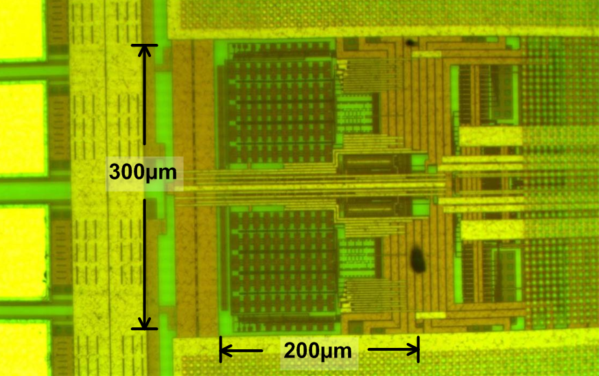
FITSAR Prototype Layout
FITSAR Die Photo
FITSAR Prototype Layout
  Area is 0.06mm²
  Fabricated in National 0.13u CMOS
  Psudo-differential layout
FITSAR Floorplan

Slide 57
FITSAR Transistor Level Simulations
Spec/Date | FITSAR 1.2V | FITSAR 0.8V | TSAR 0.8V
ENOB | 11.76 | 11.18 | 9.85
Frequency | 50 MHz | 10 MHz | 8 MHz
Power | 362 uW | 32.8 uW | 75.2 uW
Process (VDD) | Optimos2 (1.2) | Optimos2 (0.8) | Jazz 0.13u (0.8)
FOM | 2.08 fJ/CS | 1.41 fJ/CS | 10.0 fJ/CS

Slide 58
SAR ADC Outline
SAR Motivation
MCS and EMCS Structures
The Ternary SAR (TSAR)
Residue Shaping
The Feedback Initialized TSAR
Conclusions

Slide 59
Published Work
J. Guerber, H. Venkatram, M. Gande, and U. Moon, “A Ternary R2R DAC Design for Improved Energy Efficiency,” Elec. Letters, Submitted Dec. 2012.
J. Guerber, M. Gande, H. Venkatram, A. Waters, U. Moon, “A 10b Ternary SAR ADC with Quantization Time Information Utilization,” IEEE J. Solid State Circuits. Nov. 2012.
J. Guerber, M. Gande, U. Moon, “The Analysis and Application of Redundant Multi-Stage ADC Resolution Improvements Through PDF Residue Shaping,” IEEE Trans. Circuits Syst. I, Fundam. Theory Appl., Aug. 2012.
J. Guerber, H. Venkatram, T. Oh, U. Moon, “Enhanced SAR ADC Energy Efficiency from the Early Reset Merged Capacitor Switching Algorithm,” IEEE Int. Symp. Circuits Syst., May 2012.
J. Guerber, M. Gande, H. Venkatram, A. Waters, U. Moon, “A 10b Ternary SAR ADC with Decision Time Quantization Based Redundancy,” IEEE Asian Solid-State Circuits Conf. Nov. 2011, pp. 63-65.

Slide 60
Conclusions
Energy Efficient SAR Architectural Changes
  Switching efficiency though EMCS, TSAR, and FITSAR
  Comparison Reduction through TSAR and FITSAR
  Stage Skipping and grouping though TSAR
  Recoding and Nesting with FITSAR
ADC Sample Rate Enhancements
  Comparator speed enhancements though TSAR
  Coarse SAR speed increase in FITSAR
Accuracy Improvements
  Residue shaping SQNR increases in TSAR, FITSAR, and pipelined structures
  1.5b/stage redundancy shown in TSAR and FITSAR

Slide 61
Questions

Slide 62
Backup Slides
Residue Shaping with Sub-Radix
TSAR Core Timing Diagram
TSAR Capacitor Layout
TSAR Quantizer Schematic
TSAR State Machine Logic
FITSAR Core Blocks
FITSAR Coarse Logic (EMCS)

Slide 63
Residue Shaping with Sub-Radix
Sub-Radix Redundancy Residue Shaping
Residue Shaping is not Present in Sub-Radix
  PDF does shape, but does not minimize full-scale range due to effective 1 bit quantization per stage

Slide 64
TSAR Core Timing Diagram

Slide 65
TSAR Capacitor Layout
Layout in Unit Elements
  Common centroid to fix first order gradients
  Maintain average distance to center
  Digital inputs all enter from right
  Virtual ground exits on left

Slide 66
TSAR Quantizer Schematic

Slide 67
TSAR State Machine Logic

Slide 68
FITSAR Core Blocks
Reference Mux
Internal Clock Generator

Slide 69
FITSAR Coarse Logic (EMCS)

Slide 70
FITSAR Fine Logic (Gating)

Slide 71
TSAR Layout Floorplan

Slide 72
TSAR Prototype Test Setup

Slide 73
References I
V. Hariprasath, J. Guerber, S.-H. Lee, and U. Moon, “Merged capacitor switching based SAR ADC with highest switching energy-efficiency,” Electron. Lett., vol. 46, pp. 620-621, Apr. 29, 2010.
Y. Zhu, C.-H. Chan, et al., “A 10b 100MS/s reference-free SAR ADC in 90nm CMOS,” IEEE J. Solid-State Circuits, vol. 45, pp. 1111-1121, Jun. 2010.
J. Yang, T. Naing, and R. Brodersen, “A 1 GS/s 6b 6.7mW successive approximation ADC using asynchronous processing,” IEEE J. Solid-State Circuits, vol. 45, no. 8, pp. 1469-1478, Aug. 2010.
C.-C. Liu, S.-J. Chang, et al., “A 1V 11fJ/conversion-step 10b 10MS/s asynchronous SAR ADC in 0.18um CMOS,” IEEE Symp. On VLSI Circuits, June 2010, pp. 241-242.

Slide 74
References II
B. Levy, “A propagation analysis of residual distribution in pipeline ADCs,” IEEE Trans. Circuits Syst. I, Fundam. Theory Appl., vol. 58, no. 10, pp. 2366-2376, Oct. 2011.
M. Dessouky, A. Kaiser, “Very low-voltage digital-audio ΔΣ modulator with 88-dB dynamic range using local switch bootstrapping,” IEEE J. Solid-State Circuits, vol. 36, no. 3, Mar. 2001.

